Slide 1

Global Directory
Prepared by:
Saurav Gupta (2005JCA2425)
Supervised by:
Dr. Rajesh Bhat (Computer Services Centre)

Slide 2
Objective
  A System to capture personal information of an Individual.
  System which can be used for Data Analysis or for Census.
  Secured data storage
  Secured Mechanism of contacting your friends and to send messages.

Slide 3
Overview
Global Directory
  An online Directory of personal information – personal details, family details and etc.
  Accessible by any community of users but requires login and Password.
  Can contact any other Member via secured Mechanism.
  All information is stored in cryptic.
  Information captured is divided into two domains –
      Private Domain
      Public Domain

Slide 4
Overview contd... (PINs / Domains)
We would be generating two unique PINs for each member.
K-PIN (Key Personal Identification Number)
  Generated based on key information – Public Domain
  Key information is not updatable.
  Name, DOB etc...
V-PIN (Variable PIN)
  Generated based on variable information – Private Domain
  This information is updatable.
  Contact Details, Property Details etc...
Auto-generated KPIN on Sign-up

Slide 5
Scope Inclusion and Exclusion
Scope Inclusion
  Analyze the algorithms to store information in cryptic and compressed form in Database.
  Create forms to collect data.
  Provide Secured Mechanism to contact your friends
Scope Exclusion
  Implementation of algorithm to store data in compressed form.
  Data Analysis.
Assumptions and Dependencies
  Information entered by member is correct and accurate.
  System cannot check for the authenticity of the entered information.
  Regular Data verifications can be done to check for data authenticity.

Slide 6
Project Phases
To meet the project objectives within the given time frame, the project is implemented in the following phases:
Study and Acquire Knowledge | Analyzing Algorithms | System Designing | Implementation
Define Scope of Project Environment setup Study of different existing Compression and Encoding Techniques Learning Technologies – ASP.NET 2.0 and SQL Server 2005 | Compare different algorithms Come-up with the appropriate algorithm for Compressed data storage | Design Database Architecture Design Layout of Pages | Create forms to collect data Implement the Algorithm.

Slide 7
Algorithms Analyzed and Challenges
Perform the compression and encoding of the data and to store all the information in cryptic format in database.
For generating KPIN, we need to restrict the length of the KPIN (Username) also as the member has to remember and enter it on the portal to login into Global Directory. So the length of the KPIN is restricted to 10.
Several existing algorithms are studied to achieve the Compression/Encoding of data and to generate the PINs but each of them has some limitation. Few are mentioned below:
  During compression, there is some loss of information.
  The characters representing the compressed form are not enterable characters
  The Length of the encoding technique used has no limit on length of characters.
  The Length of compressed string may vary with the data and can cross our initial limit of 10 characters of KPIN.
Due to the challenges, not anticipated at the start of project, the implementation of the algorithm can be taken up in Major Part – II.

Slide 8
System Architecture
A client-server application is a distributed system comprising both client and server software.
A client software process initiates a communication session, while the server waits for requests from any client.
A Web Browser is a client program at the user computer that may access information at any web server in the world.
A Web Server is a computer program that is responsible for accepting HTTP requests from Web, and serving them HTTP responses along with optional data contents.
Since data storage is centralized, updates to that data are easier to administer.
Client Server –
Web Browser
Request for page
Web Server
Request for data
Database
HTML Page with required contents
Received Data
Client-Server Model

Slide 9
Technical Architecture – MVC
The goal of the MVC design pattern is to separate the application object (model) from the way it is represented to the user (view) from the way in which the user controls it (controller) .
Model: The model object knows about all the data that need to be displayed. It only represents the data of an application.
View: The view represents the presentation of the application. The view object refers to the model. It uses the query methods of the model to obtain the contents and renders it.
Controller: Whenever the user sends a request for something then it always go through the controller. The controller is responsible for intercepting the requests from view and passes it to the model for the appropriate action.
Advantages:
  Multiple views using the same model
  Easier support for new types of clients
  Clarity of design
  Efficient modularity
  Ease of growth

Slide 10
Information Captured
Family Details
Contact Details
Offspring Details
Sibling Details
Birth/Deaths in Family
Others Details
  Educational Details
  Professional Details
  Property Details

Slide 11
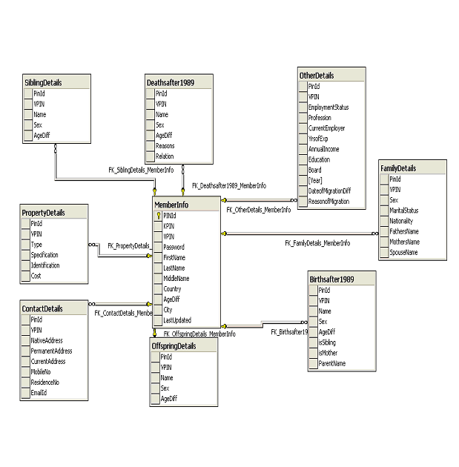
Database Diagram

Slide 12
Use Case Diagram
Create an account
Update your personal Details
Search your friend
User
Send Message to an Individual
Send Message to a Group
Get KPIN

Slide 13
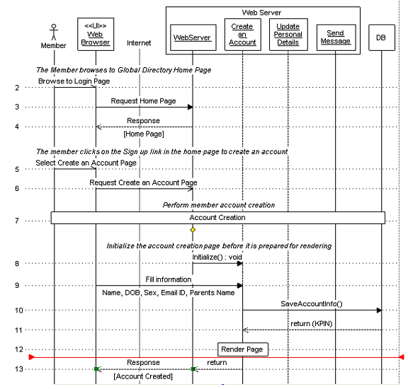
Sequence Diagram – Create Account

Slide 14
Secured Communications
Allows Exchange of information via emails
Emails can be sent to a Group or an individual
Group Emails:
  Requires Approval of Email to avoid malicious emails
  Based on selected search criteria
Email to an Individual:
  No Approval required.
  But Email Id will not be shared and other member can reply via the Directory.
  Thus exchange of information without knowing the Email ID of each other, so no sharing of Personal information.

Slide 15
Salient Features
Requires less data storage space
Provides High data security
Scalable
Available Online
Easy to use

Slide 16
Technology Stack
S/W Requirement
  SQL Server
  MS Visual Studio 2005
  .NET Framework 2.0
  IIS
H/W Requirement
  Windows XP
  1 GB RAM
Client – Internet Browser
Web Server / Database Server – can be placed anywhere

Slide 17
DEMO

Slide 18
Questions ?

Slide 19
Thank You!!!

